Slide 1
Secure Data Hiding in Images Using Steganography
EDUNET PROJECT
Presented By: Rajat Kumar
Student Name: Rajat kumar
College Name & Department :
Chandigarh University ,CSE

Slide 2
OUTLINE
Problem Statement
Technology used
Wow factor
End users
Result
Conclusion
Git-hub Link
Future scope

Slide 3
Problem Statement
Secure communication is essential in today's digital world. This project involves creating a Python-based steganography tool that allows users to securely embed text messages within cover images.
Using a user-provided password, the tool encrypts and hides the message, producing an encrypted image named "encryptedImage.png."
A separate decryption program will retrieve the hidden message using the correct password. This solution ensures confidential communication via image-based steganography.

Slide 4
Technology used
Programming Language:
Python - https://www.python.org/ftp/python/3.13.2/python-3.13.2-amd64.exe
Libraries:
OpenCV for image processing - pip install opencv-python
Platform: Windows
RAM - 16.00GB
System type - 64-bit operating system, x64-based processor
Tools: Visual Studio Code
Go to the official VS Code download page: https://code.visualstudio.com/download

Slide 5
Wow factors
User-Friendly Interface: Simple inputs for covering image, message, and password.
Enhanced Security: User-defined password for both encryption and decryption.
High-Quality Output: Preserves image quality with lossless PNG format.
Versatile Decryption: Validates password to ensure authorized access.
Educational Value: Hands-on learning in steganography, cryptography, and image processing.
These features improve my project's usefulness, security, and efficiency.

Slide 6
End users
Cybersecurity Professionals: Protect sensitive information by embedding it in images.
Journalists and Whistleblowers: Communicate covertly in regions with restricted freedom of speech.
Artists and Creatives: Add hidden messages or layers of meaning to their artwork.
Researchers and Academics: Develop and improve steganography techniques.
Everyday Users: Enhance privacy by hiding personal information within images.

Slide 7
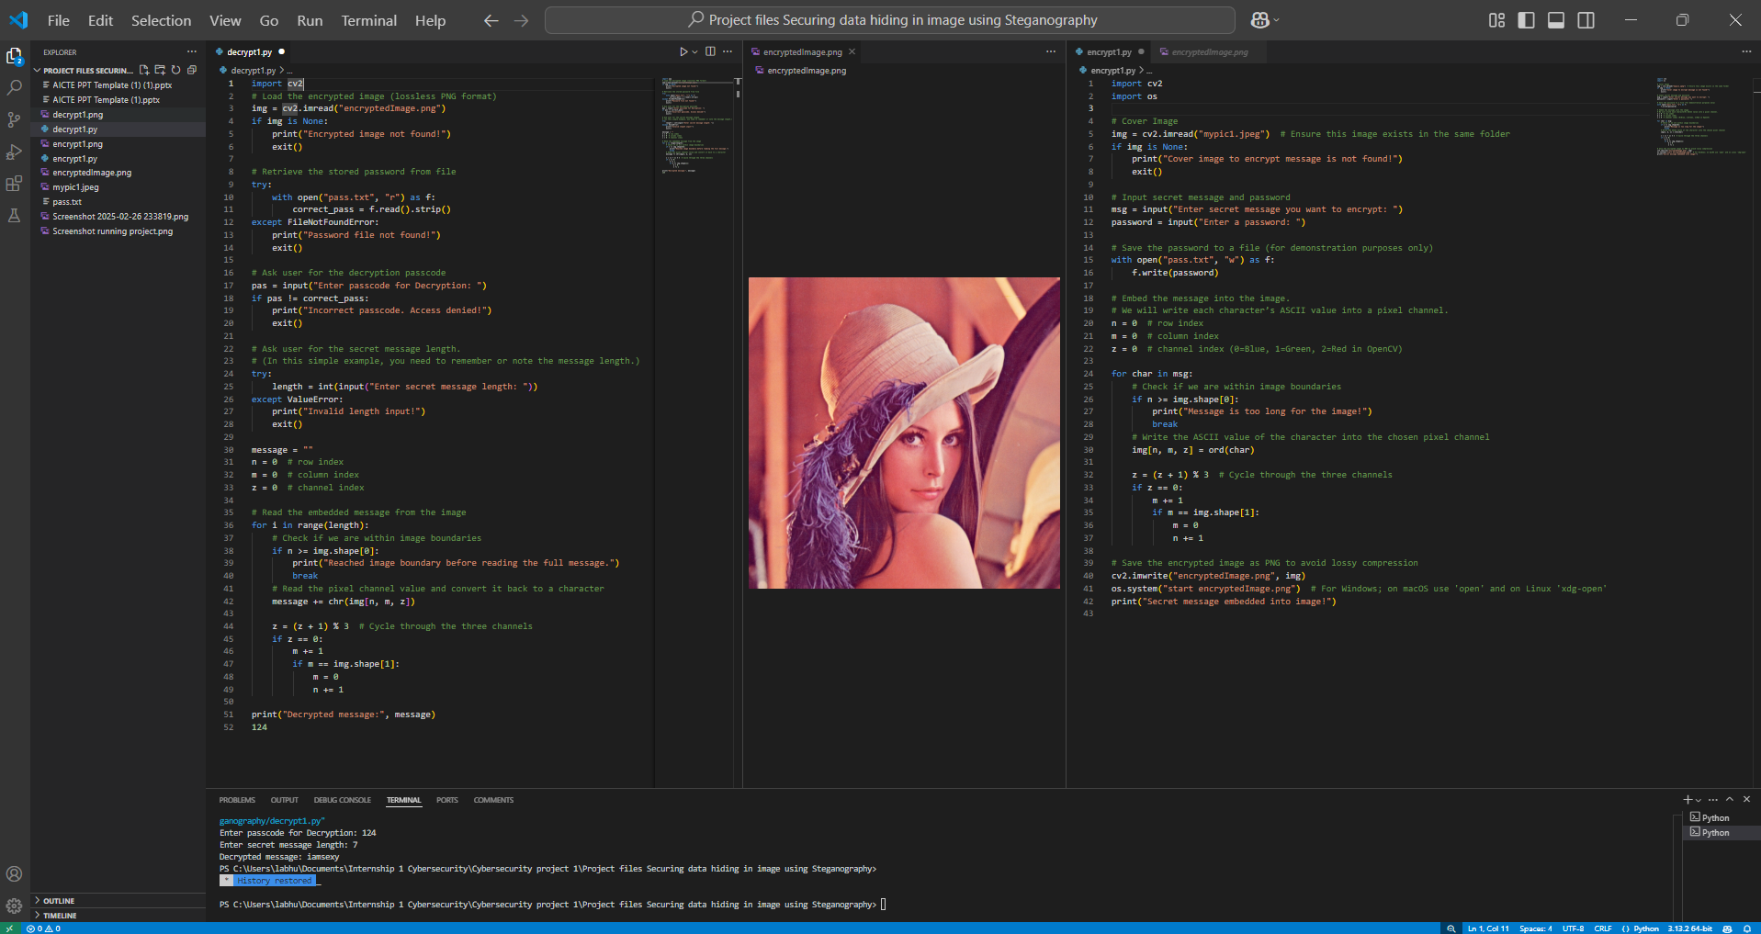
Results

Slide 8
Conclusion
This Python-based steganography provides a safe method for embedding and retrieving confidential information within photographs, guaranteeing that only authorized users have access to the hidden material. The system protects privacy and data by encrypting and decrypting using passwords provided by the user. The tool produces an output image ("encryptedImage.png") that keeps the original's visual integrity, giving it a dependable means for secure communication via image-based steganography.

Slide 9
GitHub Link
https://github.com/RajatB29/secure-data-hiding-using-steganography1.git

Slide 10
Future scope
Enhanced Security: Development of more sophisticated techniques to counter evolving cyber threats.
AI and Machine Learning Integration: Using AI/ML to create advanced steganographic methods, improving undetectability.
Improved Algorithms: Continuous enhancement of algorithms to increase data capacity and robustness.
Wider Applications: Expansion into fields like digital watermarking, secure communication, and data integrity verification.
Real-Time Steganography: Techniques for secure communication in live video streams and real-time data transmission.
Quantum Steganography: Potential use of quantum computing for unprecedented security levels.
Legal and Ethical Frameworks: Establishing guidelines to govern the use and prevent misuse of steganography.

Slide 11
THANK YOU

